Slide 1

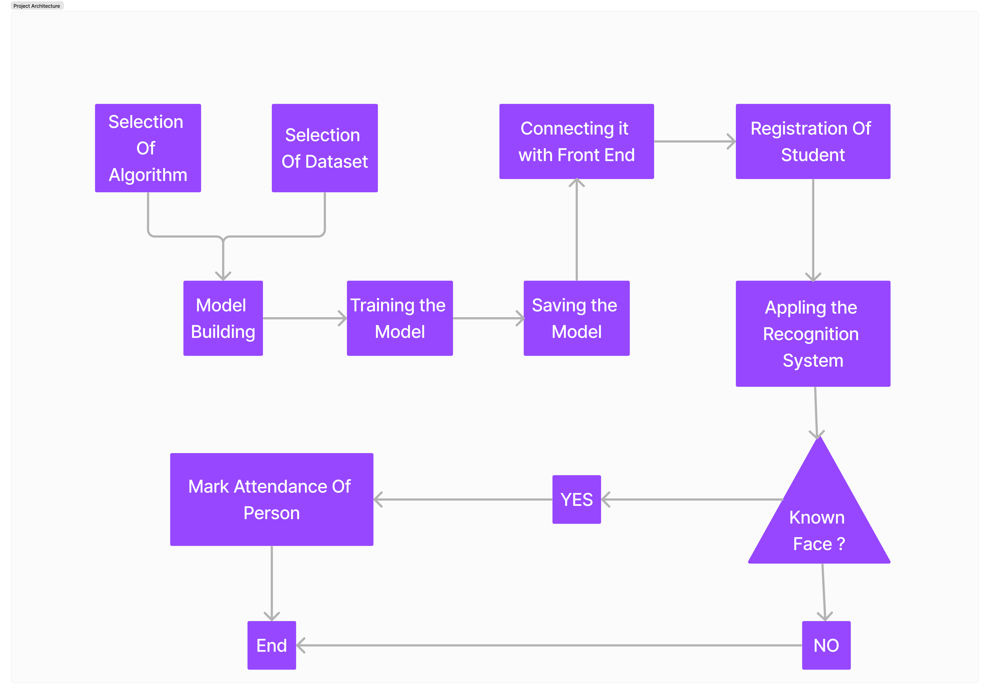
SMART ATTENDANCE MONITORING SYSTEM BASED ON FACIAL RECOGNITION
School of Computer Science and Engineering
INDUSTRY CONCLAVE 2024
THORAT AMEY ARUN – 23MCS1004
Guided By Dr. BHARATHI RAJA S
INTRODUCTION
Face recognition, often abbreviated as FR, is a cutting-edge technology that has revolutionized the way we identify and authenticate individuals.
It harnesses the power of computer vision and machine learning to analyze and interpret the unique features of a person's face.
Face recognition technology is used in smart attendance monitoring systems to automatically identify and confirm people so that their attendance can be monitored.
Students or employees can just stroll in front of a camera to have their attendance recorded without having to carry any specific cards or gadgets.
OBJECTIVES
Achieve marginal accuracy in identifying individuals in low-resolution images or videos, different angles, and different lighting conditions.
Perform recognition on moving faces, such as in real-time surveillance footage.
Reduce the power consumption of face recognition systems.
SCOPE OF THE PROJECT
The scope of this project is to help professionals to give attendance faster and more efficiently.
METHODOLOGY
Preprocessing
Using the LFW dataset, finding the face of person in images and storing it for future detection.
ARCHITECTURE
We extract the features of face using FaceNet and apply machine learning supervised learning algorithms such as KNN. We then check the classification accuracy.
RESULTS
FUTURE PLAN
Applying the hyperparameter tuning, blurring, and deblurring function on the face dataset for better accuracy.
CONCLUSION
A deep learning algorithm i.e. FaceNet was used to measure various facial features of the dataset, and accuracy was achieved with a machine learning algorithm i.e. KNN was nearly 72% convolution, which could be increased in the near future and will be helpful for face detection.
REFERENCES
Labeled Faces in the Wild dataset by Umass Amharest. https://vis-www.cs.umass.edu/lfw/(accessed Jan 16, 2024)
Jin Chen, Jun Chen, Zheng Wang, Chao Liang, and Chia-Wen Lin, “Identity-Aware Face Super-Resolution for Low-Resolution Face Recognition”, IEEE SIGNAL PROCESSING LETTERS, VOL. 27, 2020
HUDA.H.Mady, Shadi M.S. Hilles, “Efficient Real-Time Attendance System Based on Face Detection Case Study “MEDIU Staff””, International Journal of Contemporary Computer Research, 2017
Algorithm | Accuracy
FaceNet | 72.18
KNN

